Slide 1
COMP 4500
Week 4 - Friday

Slide 2
Last time
What did we talk about last time?
Scheduling to minimize lateness
Dijkstra's algorithm

Slide 3
Questions?

Slide 4
Review

Slide 5
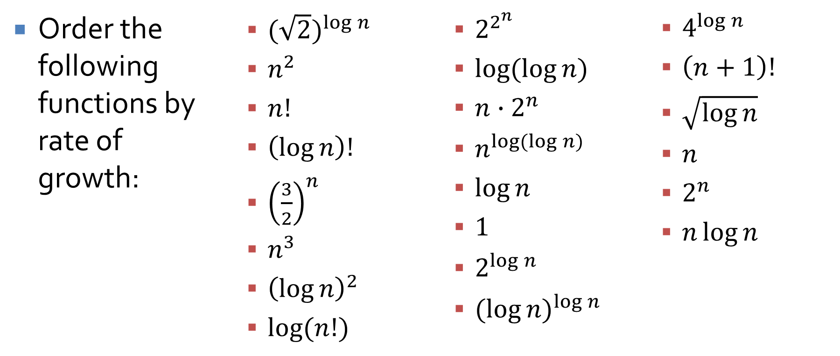
Big Oh
Order the following functions by rate of growth:
  ${(\sqrt{2})}^{\log{n}}$
  $n^{2}$
  $n!$
  $\left(\log{n}\right)!$
  ${\left(\frac{3}{2}\right)}^{n}$
  $n^{3}$
  ${\left(\log{n}\right)}^{2}$
  $\log{(n!)}$
  $2^{2^{n}}$
  $\log{(\log{n})}$
  $n{∙2}^{n}$
  $n^{\log{(\log{n})}}$
  $\log{n}$
  $1$
  $2^{\log{n}}$
  ${(log{n)}}^{\log{n}}$
  $4^{\log{n}}$
  $\left(n+1\right)!$
  $\sqrt{\log{n}}$
  $n$
  $2^{n}$
  $n\log{n}$

Slide 6
Big Oh
Determine the running time of various loops
Example:
  int counter = 0;
  for(int i = 0; i < n*n; ++i)
  for(j = 1; j <= i; ++j)
  counter++;

Slide 7
Graphs
Know basic definitions of graphs
  Nodes
  Edges
  Directed vs. undirected
  Adjacency matrix vs. adjacency lists
  Trees
  Connected
  Strongly connected

Slide 8
Graph algorithms to know
BFS
DFS
Determining bipartiteness
Find connected components
Find strongly connected components
Topological sort

Slide 9

Example proof
For all n $∈ℤ$, if n³ + 5 is odd, then n is even.
Hint: Try a proof by contradiction.

Slide 10
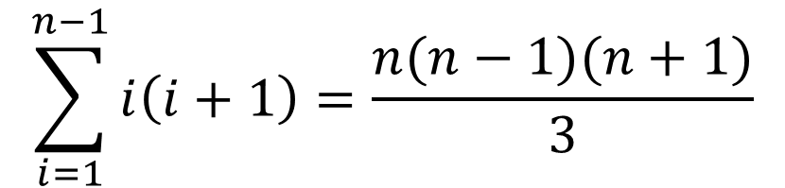
Example proof
Prove that, for all integers n ≥ 2,
Hint: Try a proof by induction.
$$\sum_{i=1}^{n−1}{i\left(i+1\right)=\frac{n(n−1)(n+1)}{3}}$$

Slide 11
Example proof
Prove that, for all integers n ≥ 1,
Hint: Try a proof by induction.

Slide 12
Example proof
Prove that a graph with two or more nodes where each node has a degree of n/2 or higher must be connected.
Hint: Try a proof by contradiction.

Slide 13
Upcoming

Slide 14
Next time…
Exam 1!

Slide 15
Reminders
Finish Assignment 2
  Due tonight before midnight
Review chapters 1 through 3

